Slide 1
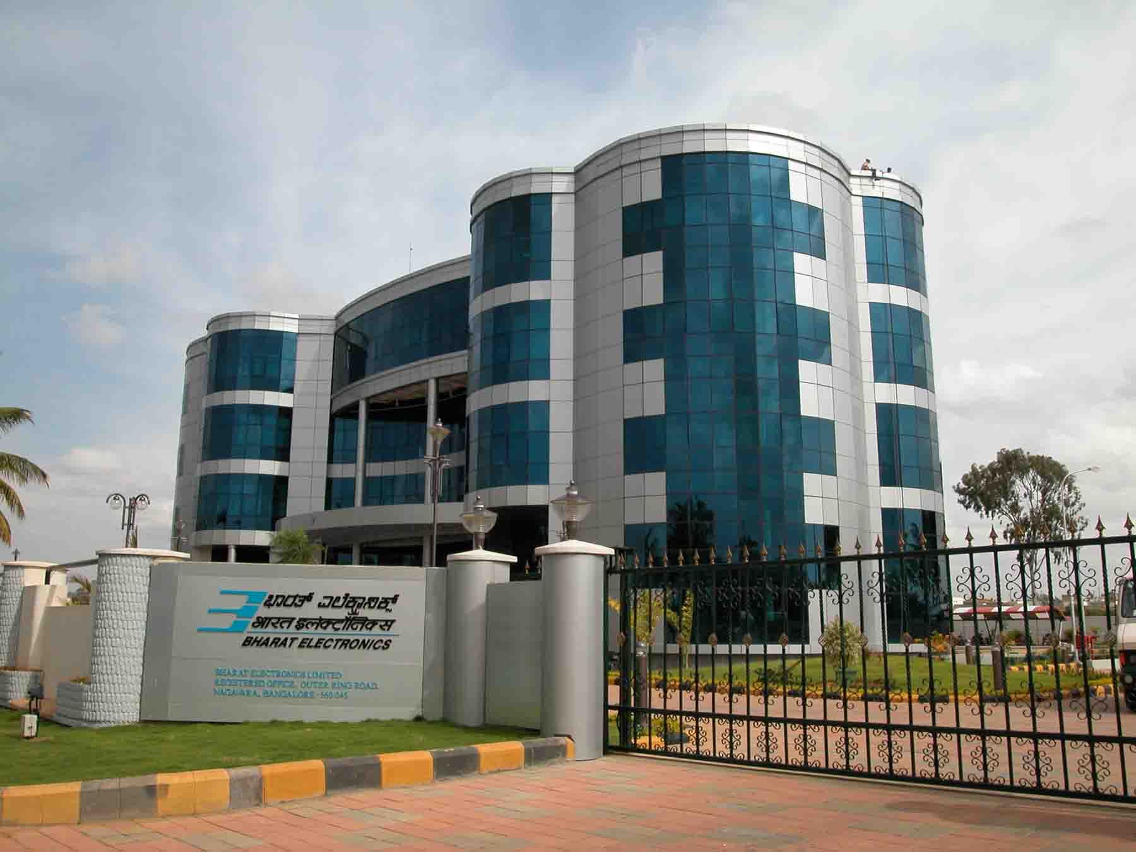
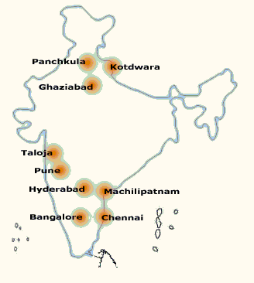
Bharat Electronics
www.bel-india.in

Slide 2
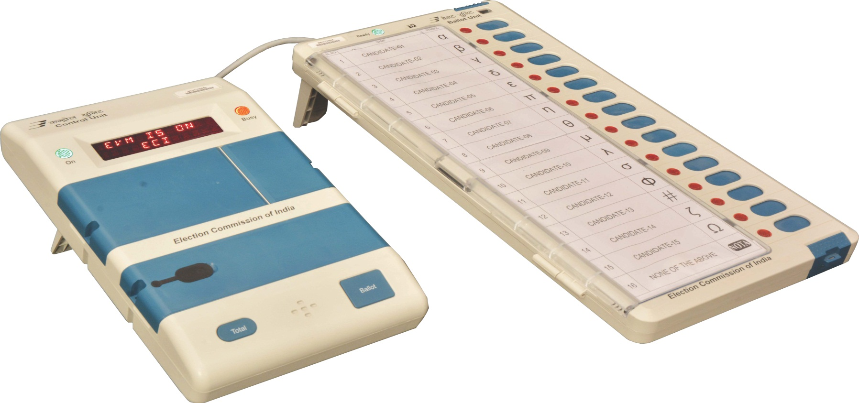
EVM
Features of
M3 Electronic Voting Machine (EVM)

Slide 3
EVM
Features of M3 EVM

Slide 4
EVM - features
Electronic Voting Machine (EVM) is a portable instrument for conducting elections to Parliament and Legislative Assembly.
The Electronic Voting Machine is a microcontroller-based instrument designed to modernize the Election process.
It is simple to operate, portable and can be installed in a short period.
There is no scope for invalid votes and total secrecy of voting data is maintained.
The EVM facilitates quick and accurate counting. It is possible to declare the results on the same day, at the end of the poll.

Slide 5
EVM - features
Special Features of the Electronic Voting Machine (EVM)
Unique Serial Number : Each Control Unit (CU) has a unique Serial Number, which matches with the metal strip number and Bar Code on the rear side of the CU.
Real Time Clock (RTC) : The real time clock is used to display the current time and date. The current date and time is displayed with ‘power on’ and on pressing the ‘Total’ button. Any malfunction of the RTC shall be displayed by ‘CLOCK ERROR’.
Status of Battery Power : Battery Power status is displayed. If change of battery is required, it also displays ‘CHANGE BATTERY’.
Print : The result of poll data can be printed, if required.

Slide 6
EVM - features
Special Features of the Electronic Voting Machine (EVM)
Authentication : Every Ballot Unit that is connected for voting is authenticated before use.
Diagnostics : Unit is used for self diagnostics that ensures proper working.
Power save mode : The unit goes into power save mode when it is idle, thus enhancing the life of the battery pack.
Braille : Moulding of Braille numerals on the Ballot Unit for visually challenged persons.
EVM operates on a special power pack (commonly known as Battery).

Slide 7
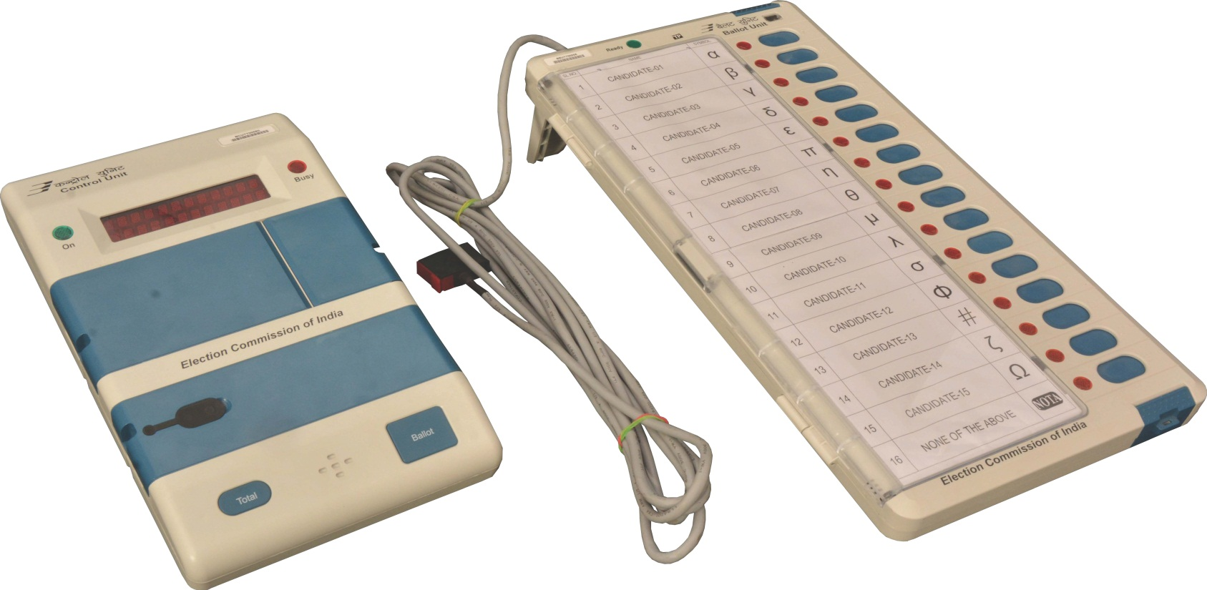
EVM - Components
Control Unit
Ballot Unit
Interconnecting Cable

Slide 8
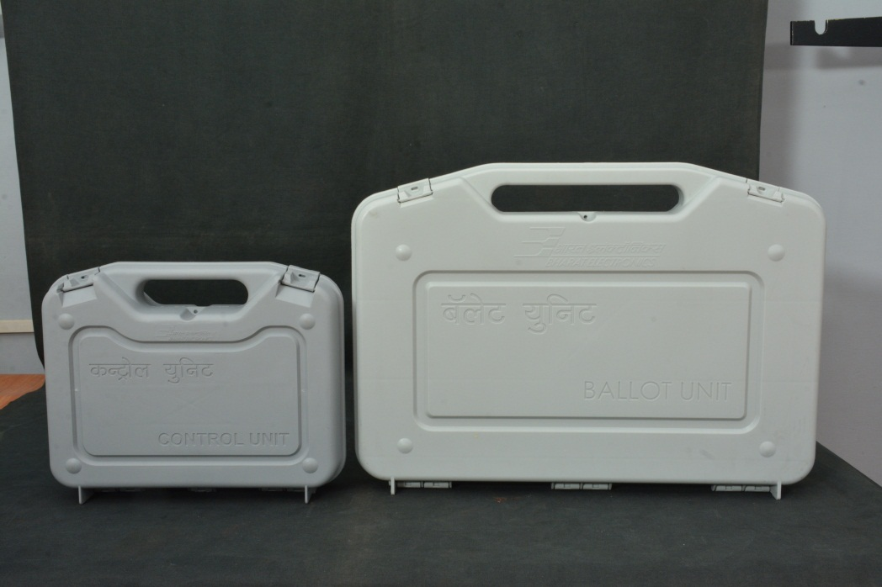
EVM – Carrying Cases
Carrying Case - Control Unit
The Control Unit and Ballot Unit are packed separately in special carrying cases
Carrying Case - Ballot Unit

Slide 9
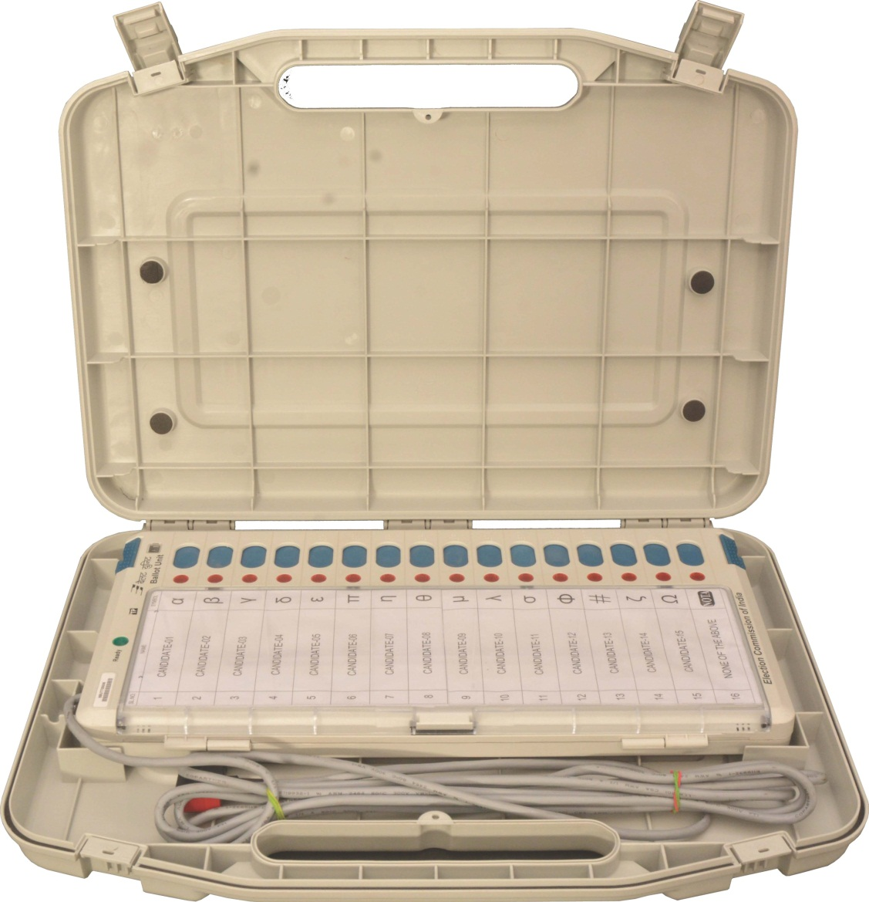
EVM – Carrying Cases/Opening
To Open the Carrying case, First lift and then push back the SIDE LATCHES and lift the carrying case top cover
Opening the carrying case of Control Unit is similar
Carrying Case - Balloting Unit – SIDE LATCHES

Slide 10
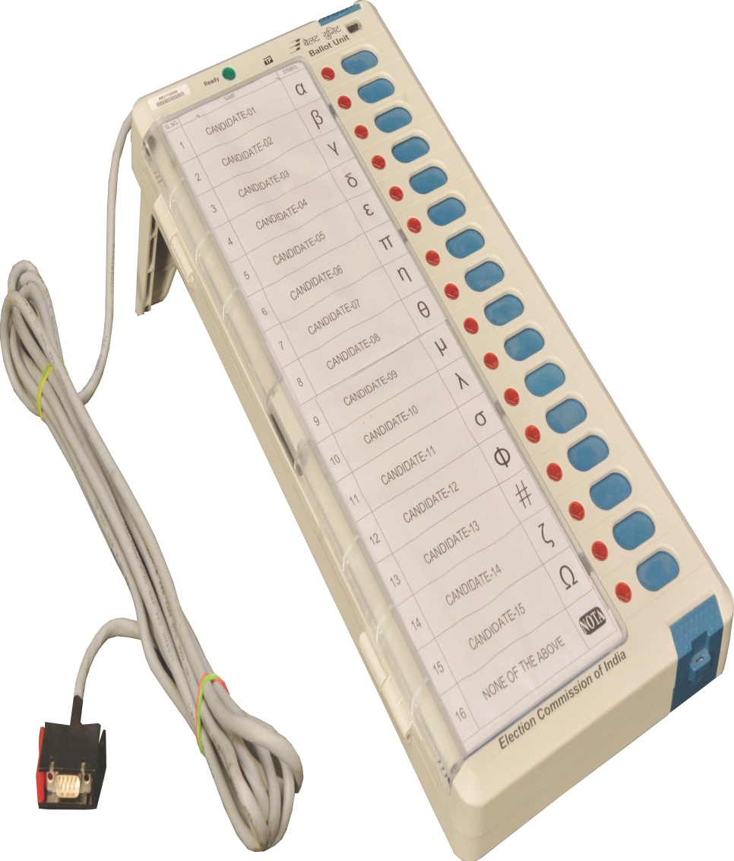
EVM – Ballot Unit
This is the unit the voter operates to exercise his / her franchise
The Interconnecting cable is permanently attached to the Ballot Unit
Front View

Slide 11
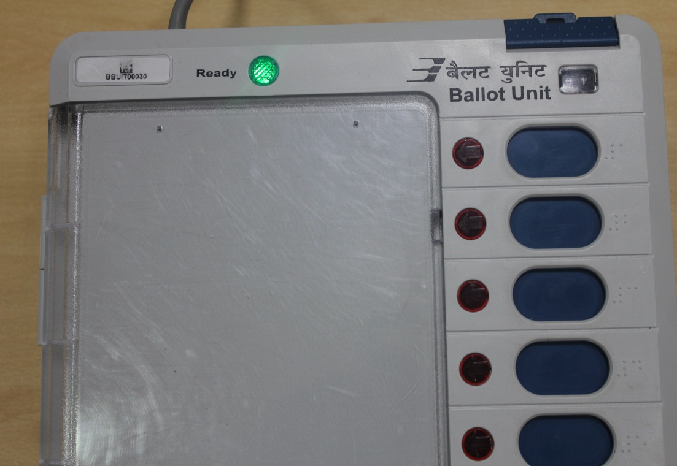
EVM – Ballot Unit - Details
Ready Lamp (Green)
Thumb Wheel Window
Candidate’s Button
Candidate’s Lamp
Ballot Paper Screen
Interconnecting Cable

Slide 12
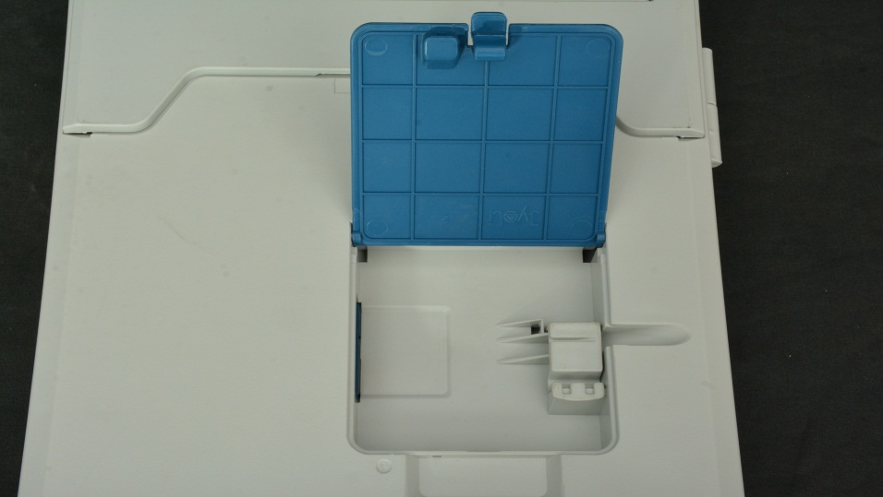
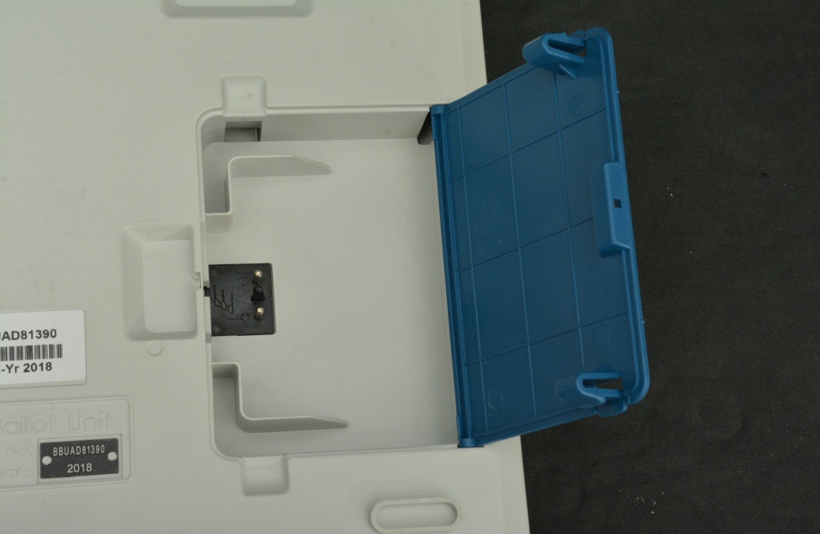
EVM – Ballot Unit – Rear View
Opening of Connector and Battery Box Door
Connector Box door
Lift to
Open
Battery Box door

Slide 13
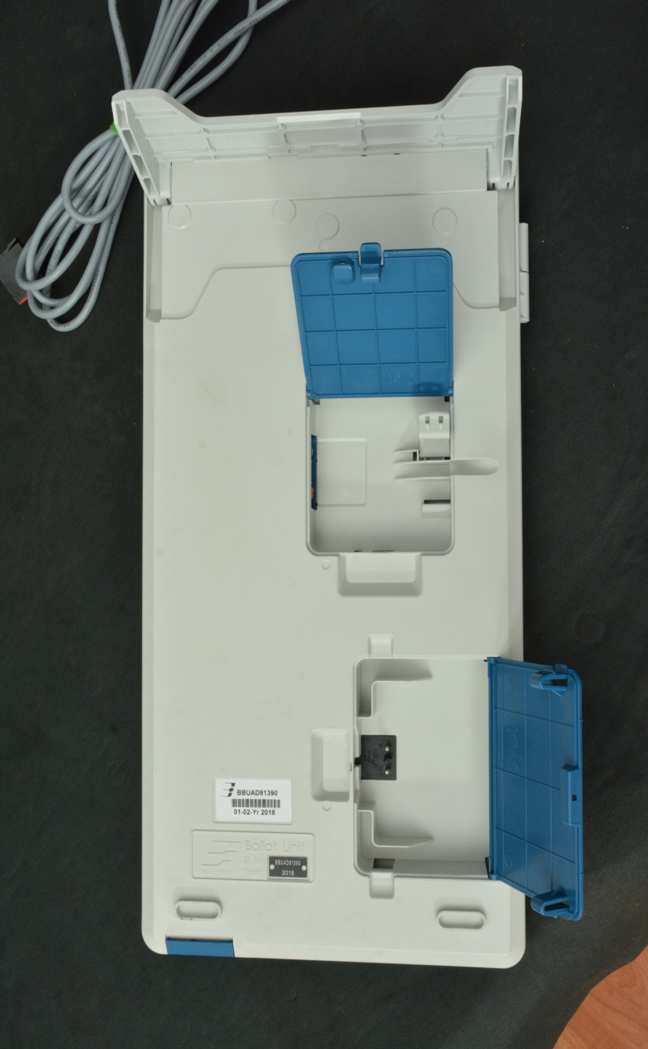
EVM – Ballot Unit – Parts in Rear View
Stand
Connector Box Door
Connector for Additional Ballot Unit
Cable Clamp
In case more than 4 Bus are used, Insert battery Pack in 5th,9th,13th,17th,21st BU
Battery Box
Door

Slide 14
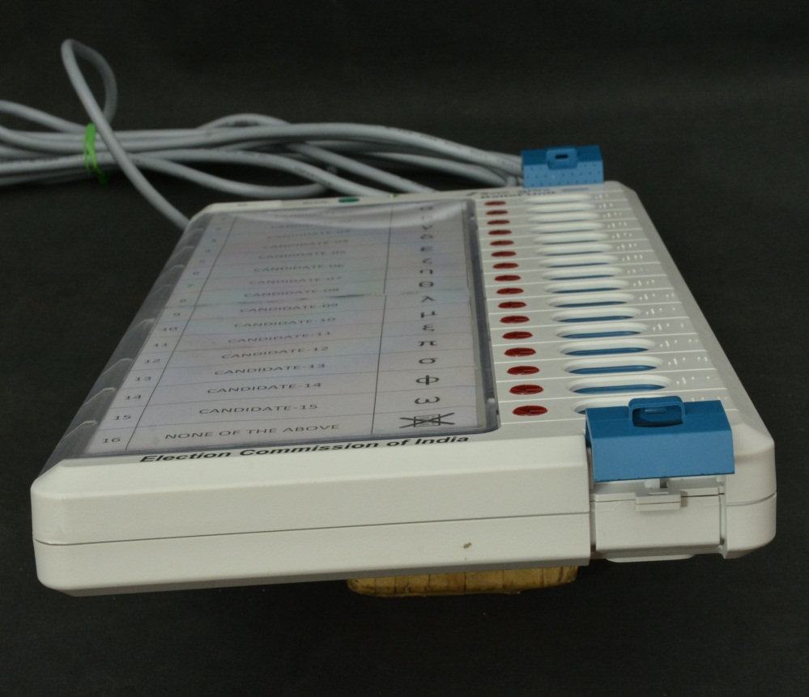
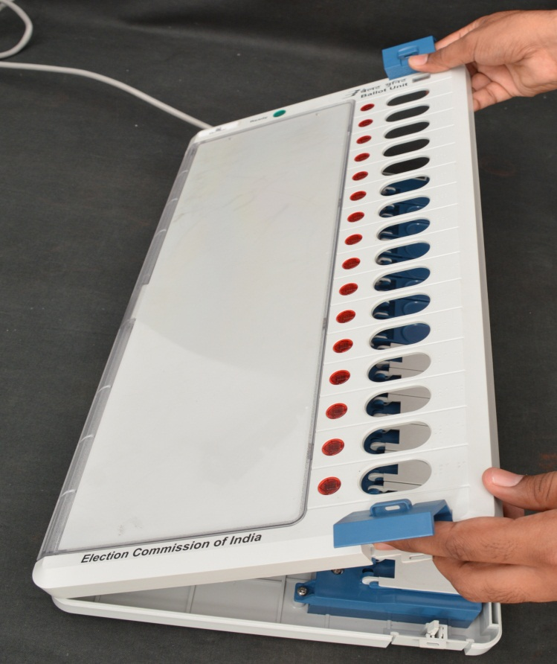
EVM – Ballot Unit – Opening of Front Door Cover
Push the Latch backwards
Lift the Cover

Slide 15
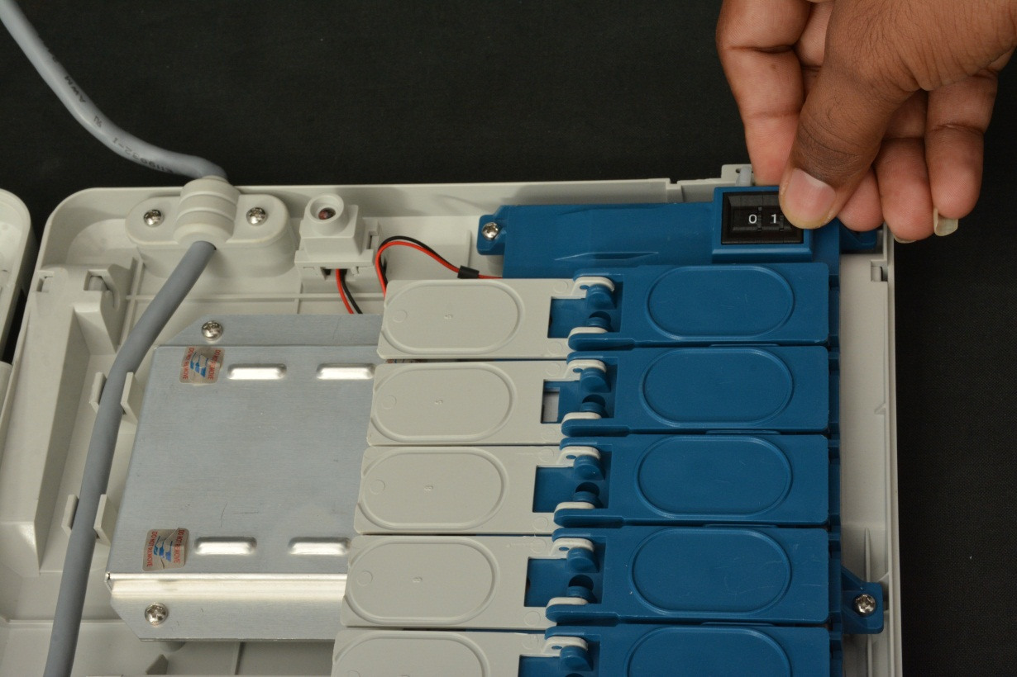
EVM – Ballot Unit – Internal Parts
Ready Lamp
Thumbs Wheel
Candidate’s Button
Masking Tab

Slide 16
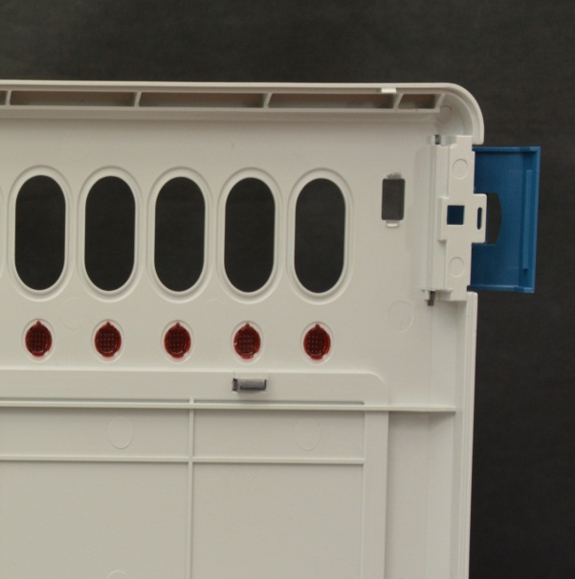
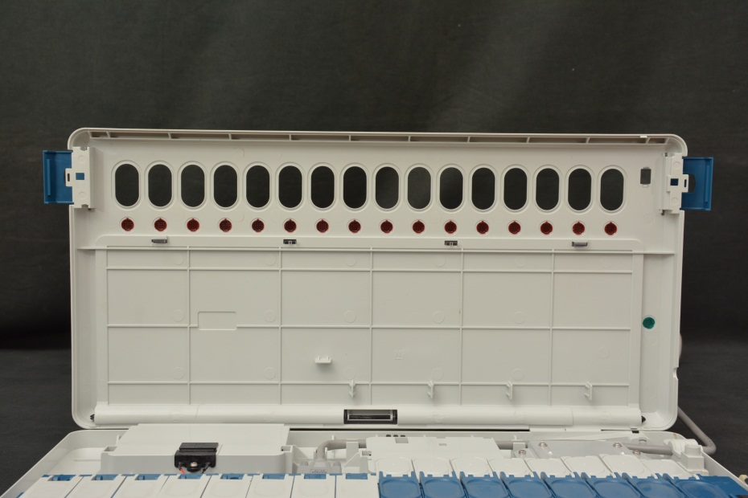
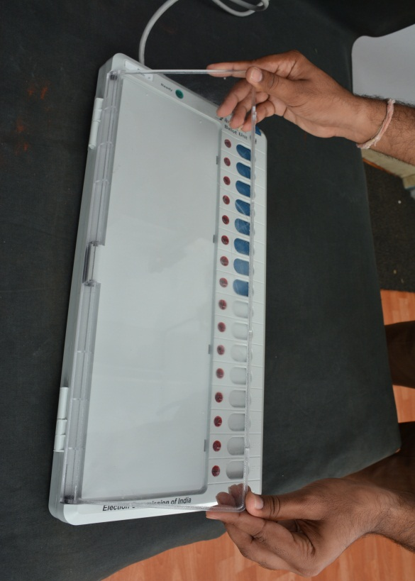
EVM – Ballot Unit
Opening of the Ballot Paper Screen
Space to fix Ballot Paper
Sealing points
Press down both the latches simultaneously and push
Latch
Screen Open

Slide 17
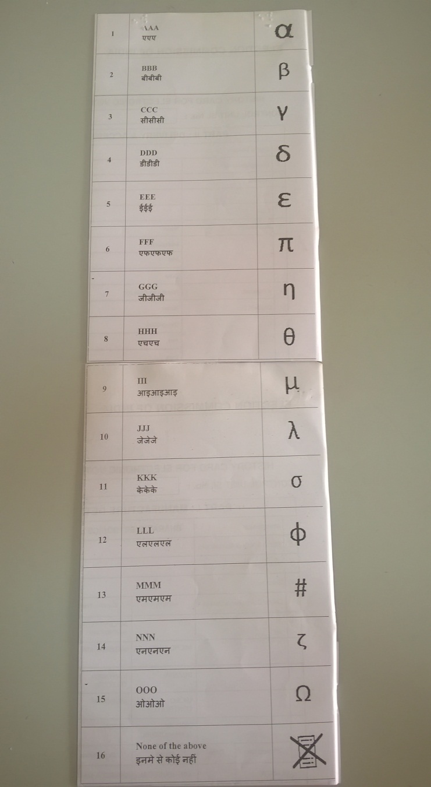
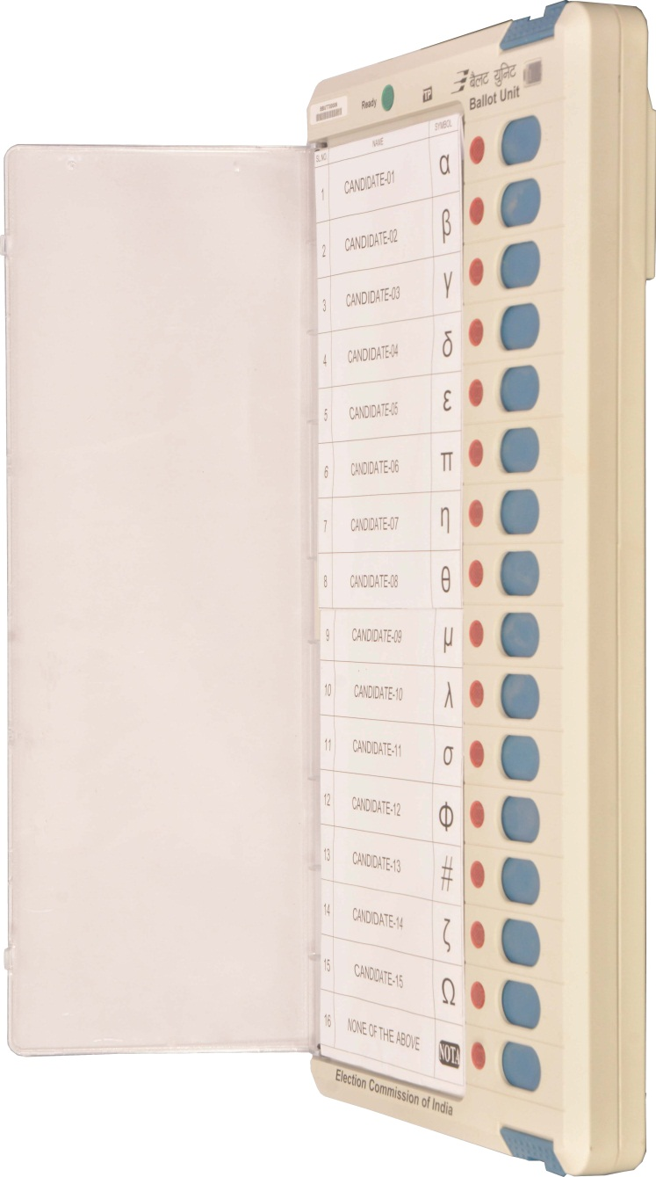
EVM – Ballot Unit
Ballot Paper
Ballot Screen

Slide 18
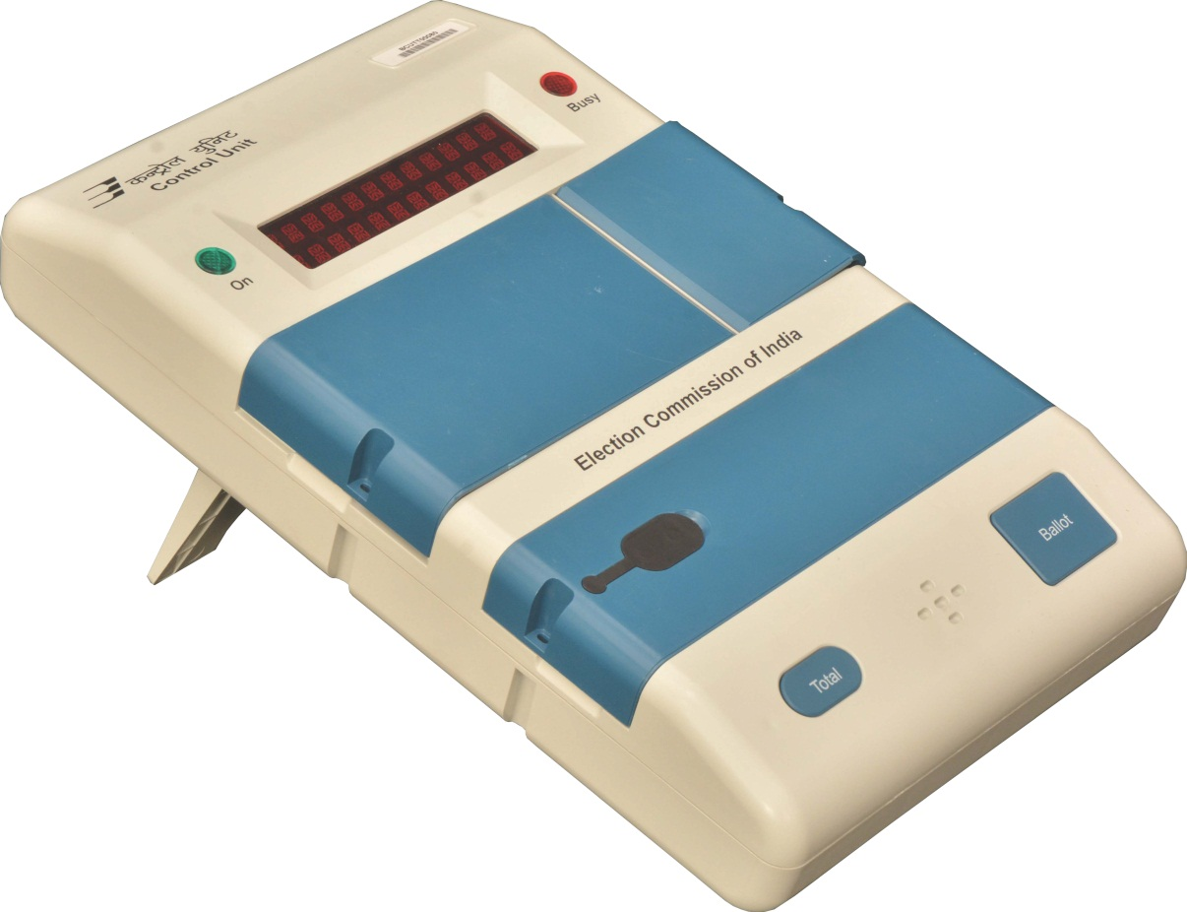
EVM – Control Unit – Front View
Power ON Lamp (Green)
Busy Lamp (Red)
Display Section
Candidate Set Section
Result Section
Ballot Section
Battery Section

Slide 19
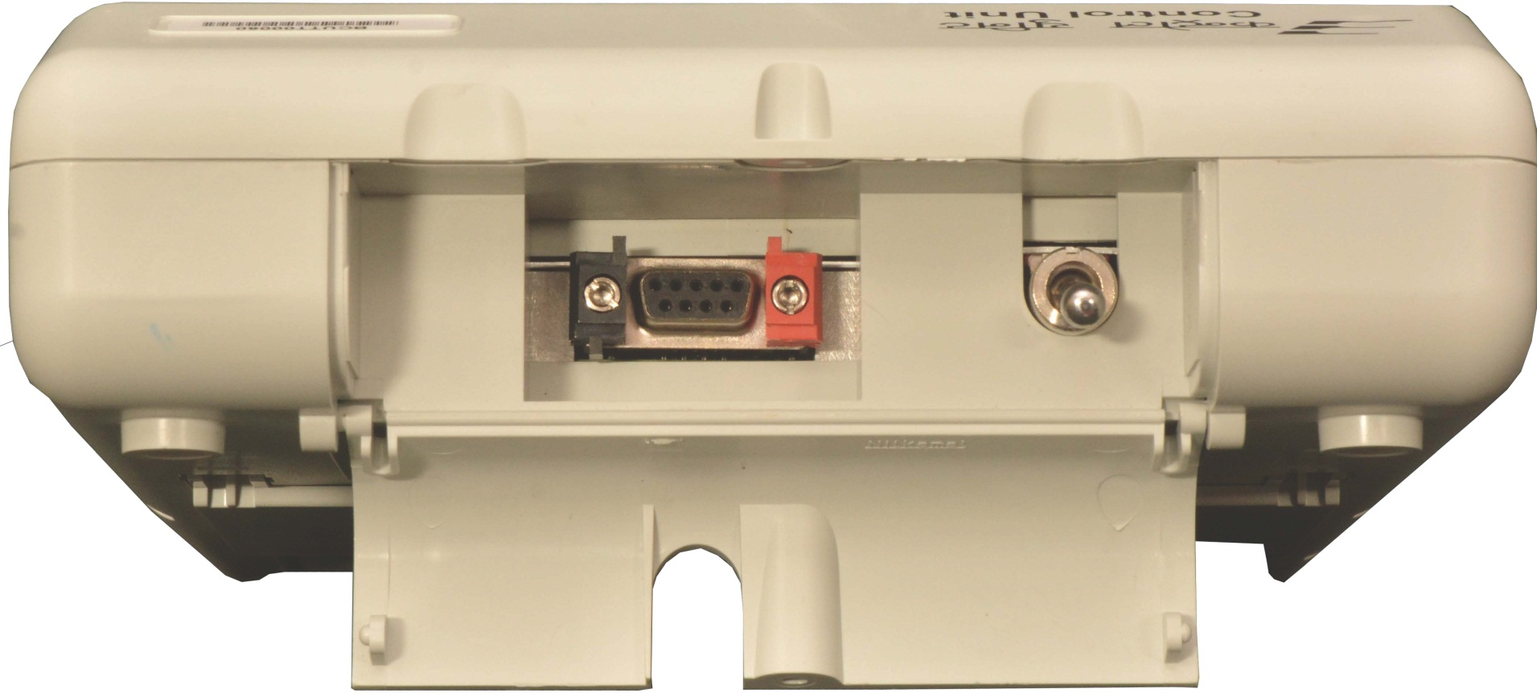
EVM – Control Unit
Opening of Bottom Compartment
Pull to open cover

Slide 20
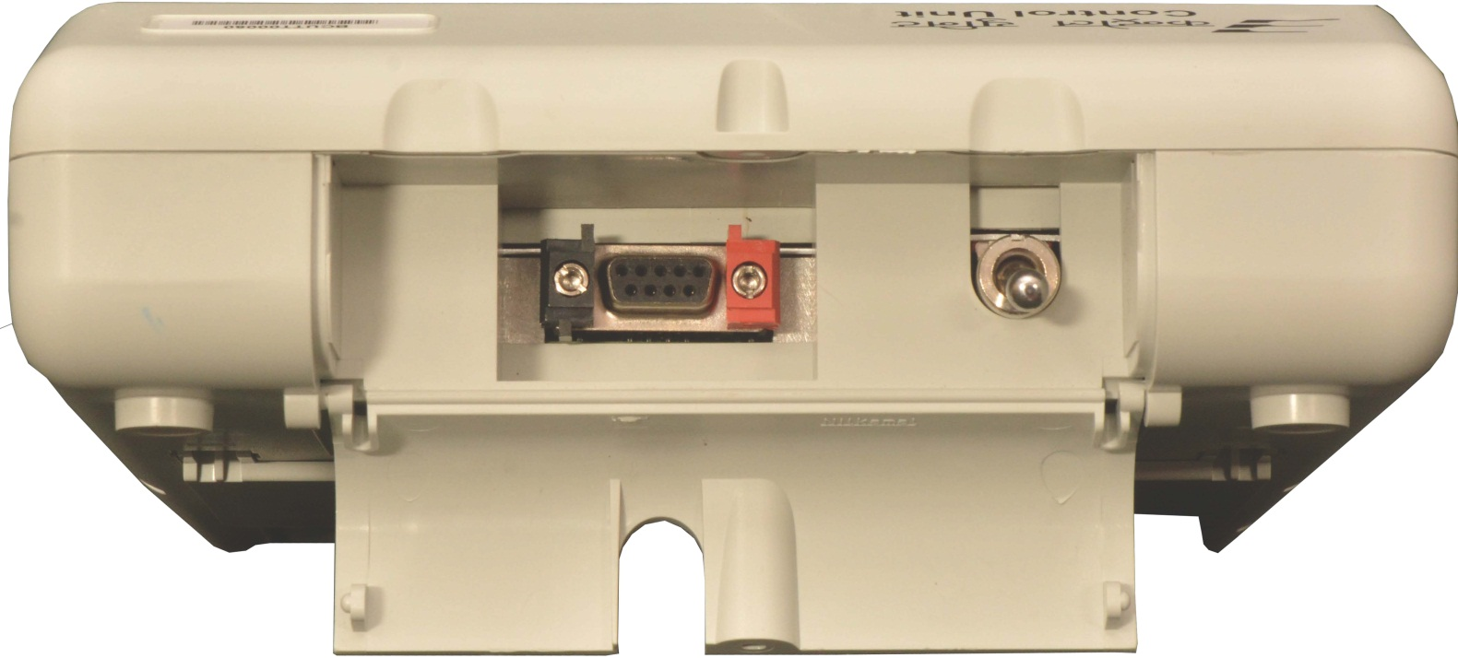
EVM – Control Unit – Bottom Compartment
Power Switch
Socket for Interconnecting Cable
of Ballot Unit

Slide 21
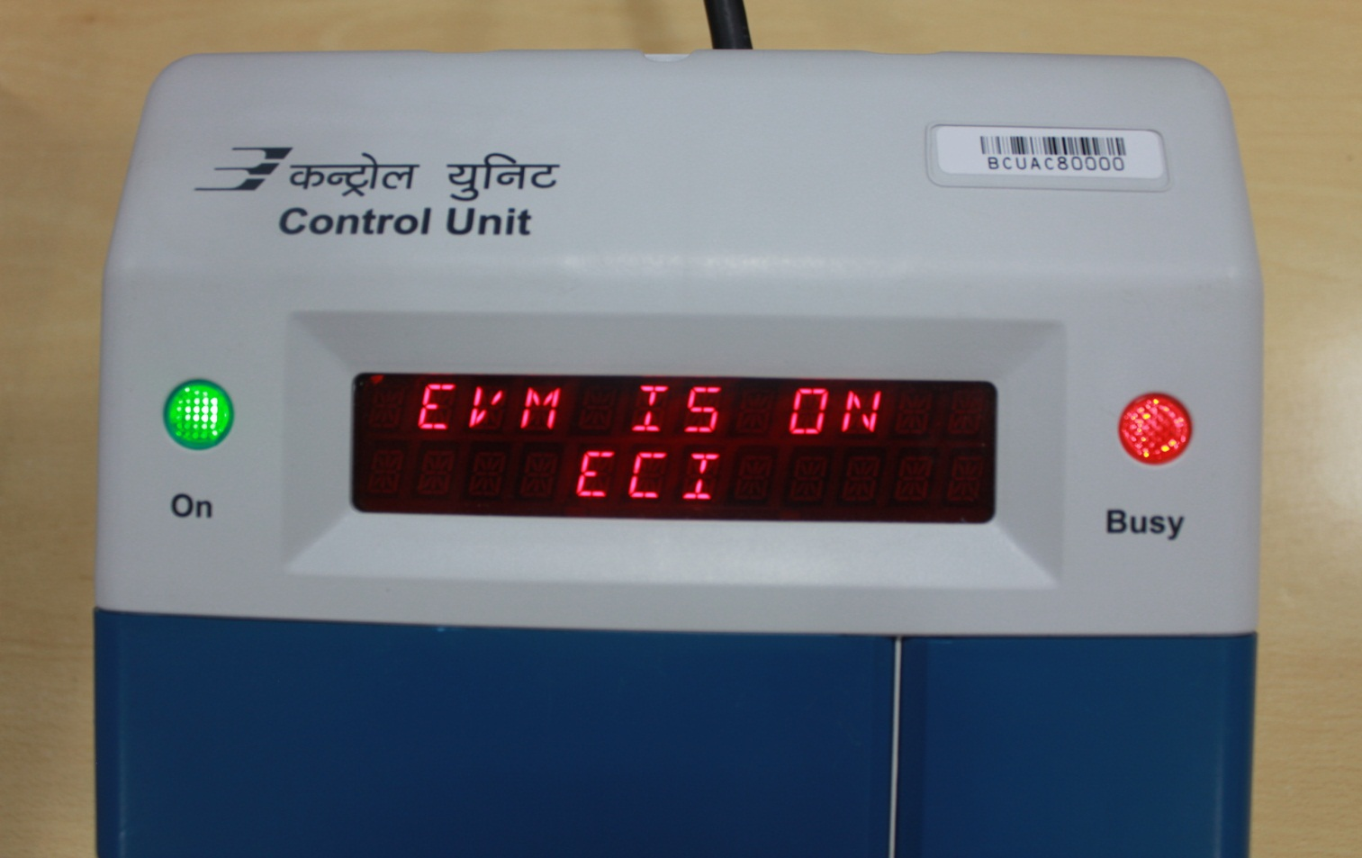
EVM – Control Unit – Display Section
Power ON Lamp (Green)
Busy Lamp (Red)
Dual Line Digital Display Panel

Slide 22
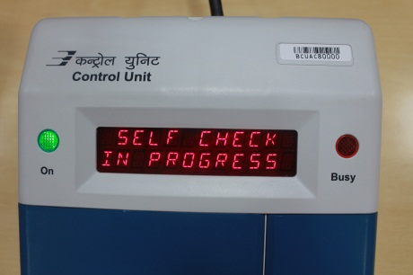
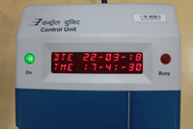
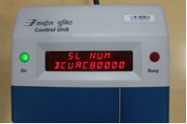
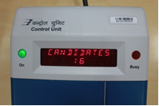
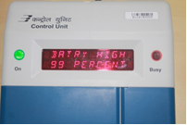
EVM – Control Unit – Display Section

Slide 23
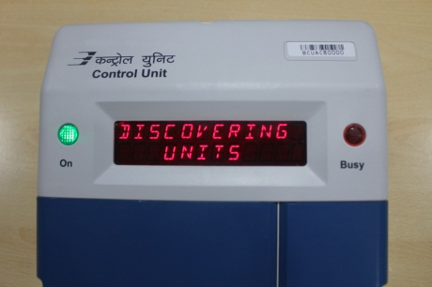
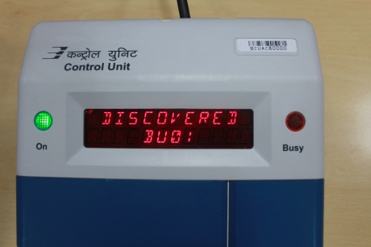
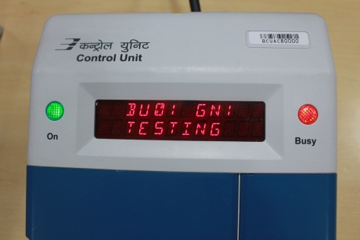
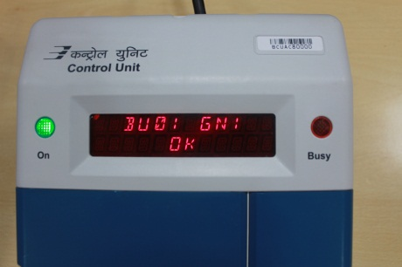
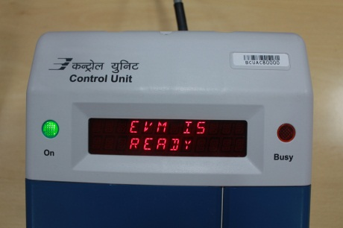
EVM – Control Unit – Display Section

Slide 24
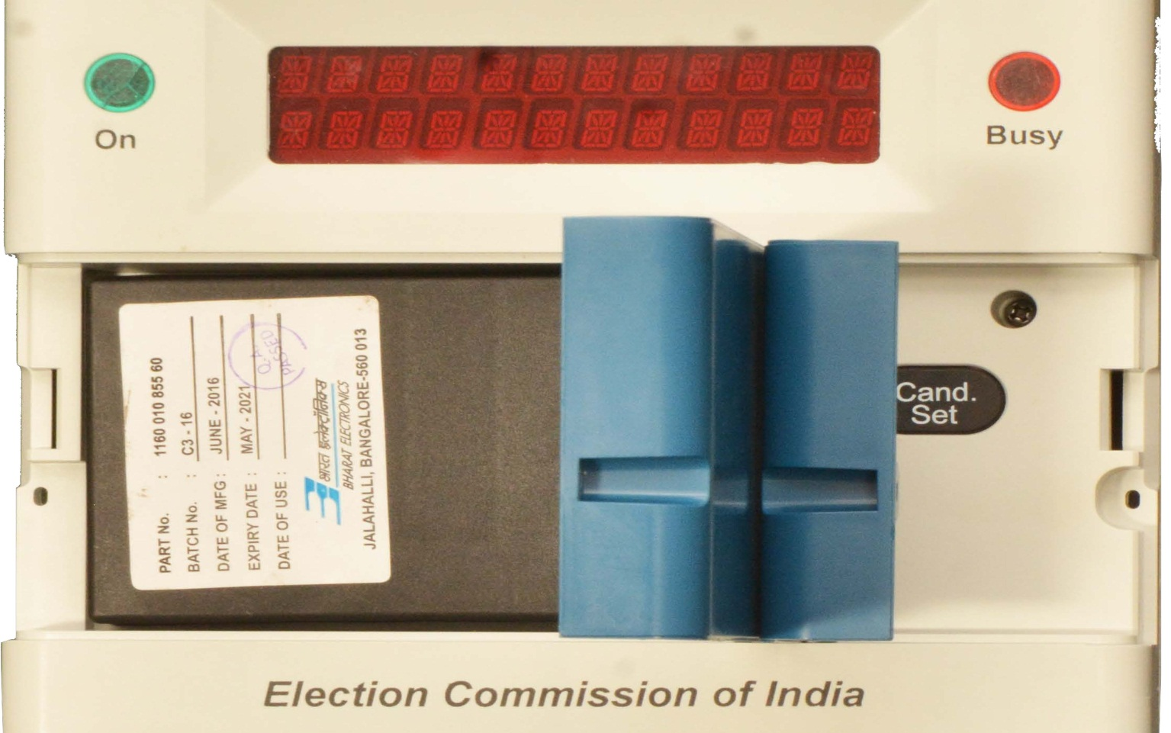
EVM – Control Unit – Candidate Set Section
Power Pack Compartment
Candidate Set
Section Outer Door
Candidate Set Button
Latch

Slide 25
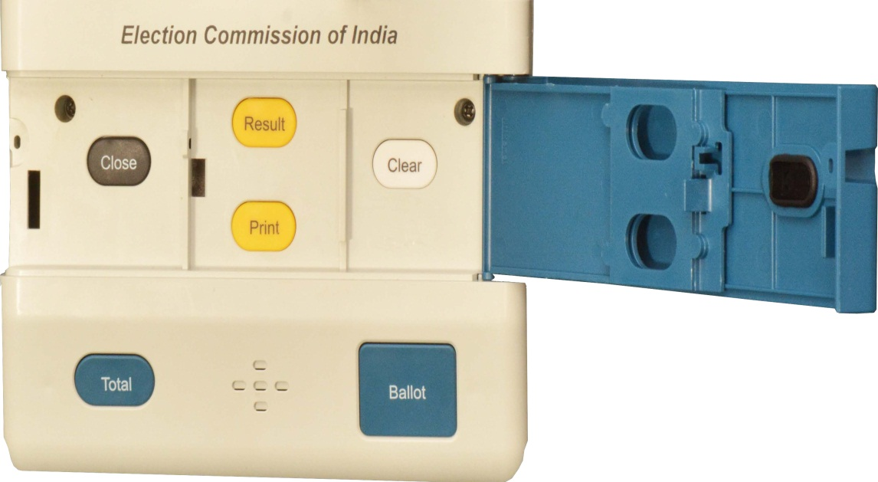
EVM – Control Unit – Result Section
Close Button
Result Button
Clear Button
Frame for Paper Seals
Inner Latches
Holes to pass thread for sealing
Print Button
Outer Door

Slide 26
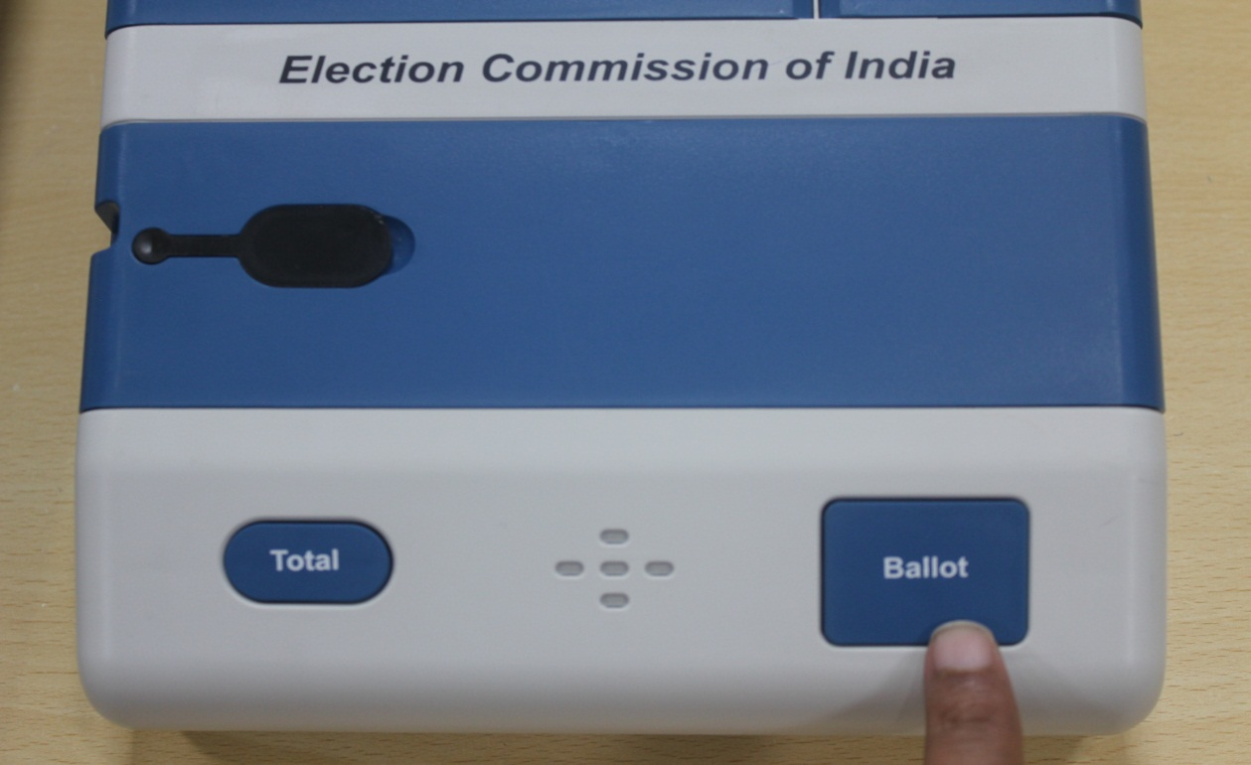
EVM – Control Unit – Ballot Section
Total Button
Ballot Button
Buzzer
Press Ballot
Button to enable
BU to take the vote

Slide 27
EVM – Display samples
CANDIDATES 16
Indicates that the EVM is set for 16 candidates
INVALID
Indicates a button on the Control unit is pressed out of sequence
FULL
Indicates that the maximum number of votes (2000) for which the EVM is designed, has been polled
BATRY HIGH
99 PERCENT
Indicates that the capacity of the Battery is High
BATRY MEDIUM
75 PERCENT
Indicates that the capacity of the Battery is Medium
BATRY LOW
35 PERCENT
Indicates that the capacity of the Battery is Low

Slide 28
EVM – Display samples
SL NUM
BCUAC80000
Indicates the CU Unit Serial Number
COMPUTING RESULT
Indicates that the RESULT is getting computed
PST 09-50-20 PET 15-32-10
Indicates the Poll Starting Time and Poll End Time
RESULT PDT 16-01-06
Indicates the Result and Date of the Poll
CANDIDATE 06 236
Indicates that the Candidate No.6 has polled 236 votes
PRINTING
Indicates the Print operation is under progress
CLOCK ERROR
Indicates that the RTC time and date is not OK

Slide 29
EVM – Display messages
Link Error
The interconnecting cable is not connected to Control Unit properly OR Thumb Wheel position in the Balloting Unit is not set at correct number OR Balloting units have not been inter-linked in correct sequence
BUXX NOT RESPONDING
Pressed Error
One of the candidates button in the Balloting Unit is either kept pressed or jammed
PRESSED ERROR
INOPERATIVE
The Control Unit cannot be used further
INOPERATIVE

Slide 30
DIFFERENCE BETWEEN EVM M2 AND M3
EVM – DIFFERENCE
SL NO. | FEATURES | EVM M2 | EVM M3
1. | Max No. of BUs | 4 | 24
2. | Max No. of Candidates | 64 | 384
3. | Self-Diagnostics | No | Yes
4. | Battery Status | High ,Medium, Low | High, Medium, Low, Marginal with percentage
5. | Tamper Detection | No | Yes
6. | Authentication Facility | No | Yes
7. | Compatible with ECIL EVM | No | Yes
8. | Candidate Set Button | Inside Battery Section | Separate

Slide 31
EVM
THANK YOU
www.bel-india.in

